Slide 1
Mastering the (extra)Ordinary
A New Red Team Maturity Model
Notes:
G
Structured approach to measuring red team’s maturity and creating a strategic roadmap

Slide 2


Speakers and Primary Contributors
Garet Stroup Director of Cyber Threat Simulation, Humana
Brent Harrell Red Team Lead, Humana
Builder, Breaker, Automator of Things
Learner, Hole-Poker, Wielder of the Flame of Sarcasm
2
Notes:
G / B
Take a moment to speak about starting in dev, moving through cyber automating and building solutions

Slide 3
AGENDA
The Problem
The Solution
Key CMM Elements
Implementation Notes
Wrap Up and Questions
3
Notes:
B

Slide 4
… Know Thyself
ΓΝΩΘΙ ΣΑΥΤΟΝ
Red Teams inform an organization’s understanding of its resiliency
How do we measure, report on, and plan for Red Team Maturity to improve that information?
4
Notes:
B
“Know Thyself” is not merely a trite attempt to appear intellectual – it’s hidden in our Red Team logo at Humana.
When you think about Red Team and Offensive Security overall, its goal is ultimately to help the organization know itself. From control effectiveness to broader cyber resiliency, the Red Team provides key data from an attacker’s lens on how the organization is doing by
Challenging assumptions we think are right
Exploring whether the controls we think we have actually work
Testing an organization’s resiliency if/when some controls fail
Finding the things about ourselves that we didn’t even know were issues
If the Red Team is to do that effectively, it must also know itself
Are we doing the right things?
Where are we, capability-wise, relative to threat actors?
What things can we change or do to improve our utility to the organization?
Do we provide the organization with the right data and testing?
Understanding those things and plotting a course forward is best done with a guide. Many other disciplines have employed a Capability Maturity Model to fill this need, but therein lies the problem: There isn’t really one for Red Team

Slide 5
A Quick CMM Review
Level 1 - Initial
Level 2 – Repeatable
Level 4 – Managed (Capable)
Level 3 - Defined
Level 5 - Optimizing
Levels provide behavioral examples
Progression requires:
Meeting the prior level (and, typically, continuing that behavior)
Meeting all the described behavior in the new level
5
Notes:
G
Additional Notes:
CMM started with software engineering and described development processes that could be improved
CMMs begin to fold in metrics and ultimately iterative improvements at levels 4 and 5 respectively

Slide 6
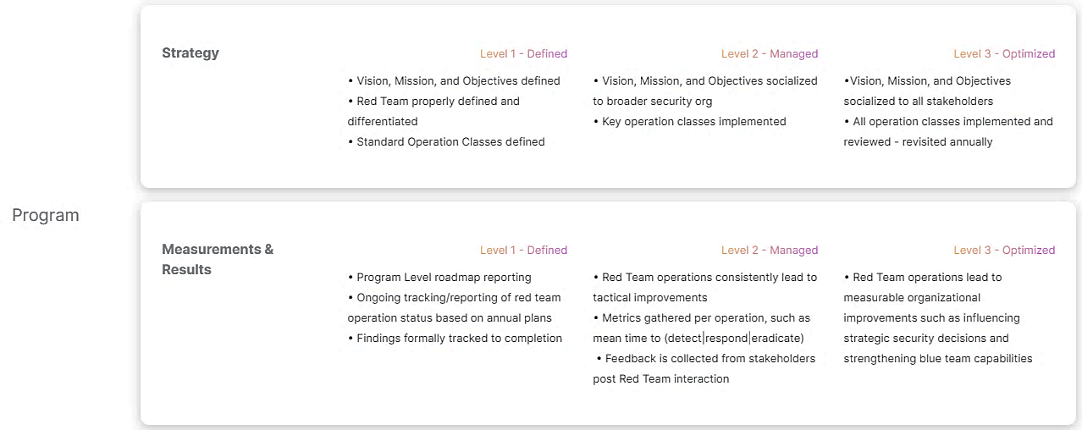
Origin Story
Credit: Jordan Potti, Noah Potti, Trent Edgeworth; redteams.fyi
6
Notes:
G
Identified this resource as we were plotting our own internal growth and taking stock of where we were
Authored by two individuals from Bishop Fox (a consultancy) and the Red Team lead at Norton Life Lock
It’s broken down into the standard four categories (People, Processes, Technology, Program) but consolidates subjects into only 9 subjects, leading to broad areas of measurement
It also only considers three levels – the last three of a typical CMM – rather than all five in a more standard format

Slide 7

Strengths and Growth Areas
[I] decided to move to a more relaxed version given the ambiguity of our industry, and the additional complexity of the traditional CMM models.
- Jordan Potti, original author
Strengths
Growth Areas
Captured a lot of areas key to a mature Red Team
Easily digested framework
Divergent format
Subjects do not consistently track across levels
7
Notes:
G
We reached out to the team to discuss our additions and Jordan shared that they initially considered a fuller offering, but elected to keep it simple
To be clear, this CMM does get a number of things right – it’s easily digested, and most of its contents do directly address Red Team maturity. We’re thankful they trod the initial path for us to build on.
As we were heading into our own internal Red Team summit, we ran into two difficulties:
Grading our maturity, and subsequently reporting it up, resulted in a language mismatch with leadership who expects to see a more traditional layout. This puts Red Team on the fringes of business again, when it should be in the fold
Beyond grading, trying to plan for where we wanted to be was difficult because elements of maturity were sporadic across the levels. Some may only be on one level, others in 1 and 3, so we ended up needing to target individual items rather than employ the CMM as it’s intended by targeting a level for a class of capabilities

Slide 8
The Solution
A standardized Capability Maturity Model
Notes:
B
We decided we couldn’t keep using the existing CMM to meet our needs and wanted to provide a better tool for both planning and reporting, leading to a new CMM

Slide 9
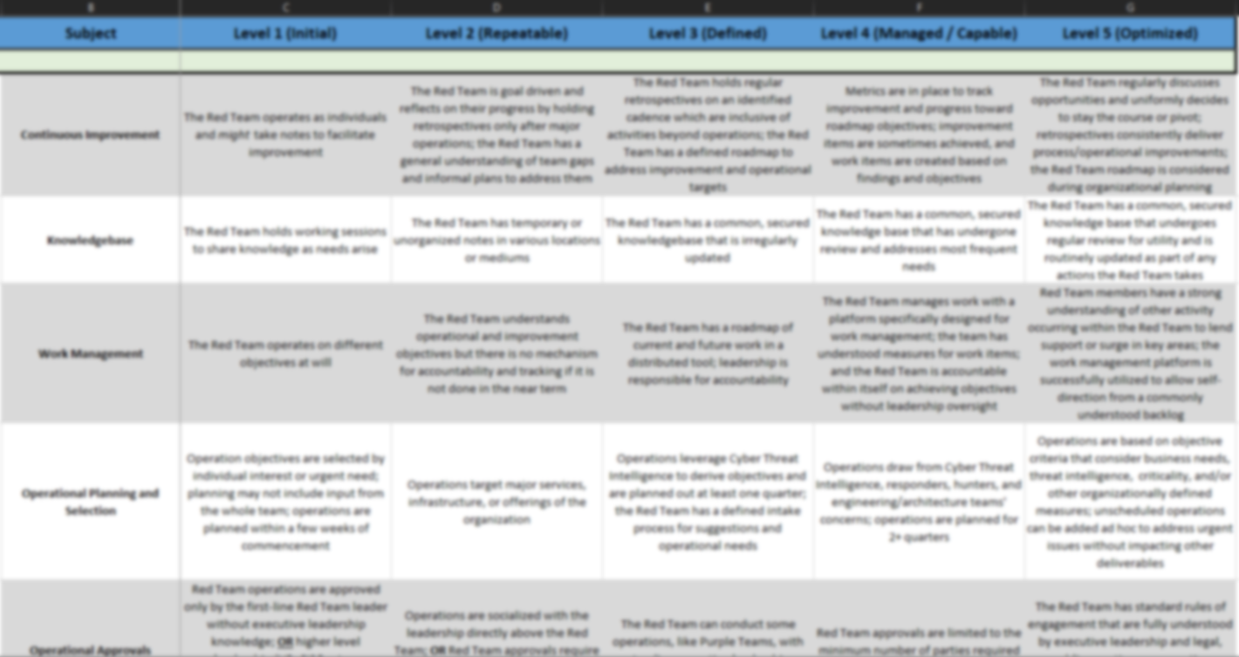
The Revised Model
Processes
Continuous Improvement
Knowledgebase
Work Management
Op Planning and Selection
Operation Approvals
Operational Documentation
Operation Reporting
Configuration Management
Resource Management
Technology
Tooling
Infrastructure
Test Environment
People
Relationship with Key Partners (7 Subjects)
Knowledge of Business and Tech Environment
Operational Capability
Development Capability
Training and Skill Development
Program
Red Team Product Lines
Strategy
Metrics
Knowledge Sharing
4 Categories
27 Subjects
Notes:
B
We will cover some elements of this model in more detail momentarily
At a high level, we took the same four categories typical of other CMMs (People, Processes, Technology, Program) and some elements of the existing CMM’s 9 subjects to provide a broader range of material
Each of these elements conforms to the industry standard 5 levels of maturity

Slide 10
Addressing Existing Challenges
Expanded from three levels to five to provide common scoring
Aligned descriptors to language from other CMMs
Added new subjects to fill gaps left by simplification
10
Notes:
B
If you recall, two of the challenges were divergent format (leading to speaking different languages with leadership), and oversimplified categories that did not provide a consistent way to measure or plan for growth
To address these things, we began our draft by considering the following fixes

Slide 11
The New challenges We Faced
Existing level descriptors left gaps for Red Team-specific needs
Action: Added new descriptors that kept with the spirit of the originals
“Additive” maturity does not work for all Red Team elements
Key offender: Technology subjects
Sliding-scale of maturity instead
Keeping the subjects unique while not creating too many
11
Notes:
B
As you might imagine, we encountered new problems during our expansion
Existing levels:
Because CMMs generally discuss processes, some elements of Red Team maturity like OPSEC or technical capability, were missing from standard level descriptors. Taking the spirit of those descriptors, we expanded common definitions to account for items needed to measure Red Team maturity
Additive maturity:
With many CMMs, each new level folds additional capability or consideration on top of existing practices. In other words, you generally keep doing “Level 3” things when you’re at level 4. We adhered to that format where we could, but some elements simply could not fit this model.
As a result, certain subjects (particularly technology-focused ones like infrastructure) became a sliding-scale – where each new level provides increasing technical capacity without always needing to account for the prior level’s behavior.
Unique Subjects:
Despite the challenges of its over-generalized subjects, we do understand the desire for simplicity with a CMM. We set out to consolidate as much as we could, while still striving to keep individual subjects unique enough that stating the team is at, or wants to achieve, a certain level provides a reasonable understanding of what that entails without combining elements that could be measured in their own right.

Slide 12
Key CMM Elements
Notes:
B
We don’t plan to cover the entirety of the CMM, but want to take a moment with this audience to highlight key usage guides – like potential points of confusion – as well as areas of particular importance to leadership and the organization. These are areas where leadership or the organization can have an out-sized impact on enabling Red Team maturity or, conversely, reap larger benefit from a higher level of maturity.

Slide 13
Key Assumptions and guidelines
This CMM is predominantly for internal red teams
The CMM presumes you have a staffed red team (not just a manager)
Except for levels that describe a negative, teams must exhibit the preceding behavior before progressing
If a team does not meet all the described behavior for a level, they cannot be at that level (including level 1)
13
Notes:
B
This slide is self explanatory
One additional note:
If a team does not meet level 1 of a particular subject, they would receive a score of 0 while still counting the subject toward the category or overall average score.
e.g., (0 + 2 + 2 + 4) / 4 subjects → average for the “Program” category

Slide 14
Processes
Processes
Continuous Improvement
Knowledgebase
Work Management
Op Planning and Selection
Operation Approvals
Operational Documentation
Operation Reporting
Configuration Management
Resource Management
Technology
Tooling
Infrastructure
Test Environment
People
Relationship with Key Partners (7 Subjects)
Knowledge of Business and Tech Environment
Operational Capability
Development Capability
Training and Skill Development
Program
Red Team Product Lines
Strategy
Metrics
Knowledge Sharing
Key Notes – Processes
(Purple items denote areas with heightened leadership or organization interest – enabling or benefiting from Red Team maturity)
Definition: Continuous Improvement - Red Team iterative improvement through planning and retrospection
Definition: Work Management – Use of practices, like Agile, to guide efforts
Note: Operational Approvals – Follows a forked path, either a bell-curve or linear downward slope ultimately leading to trust by leadership
Definition: Resource Management – Accounts, licenses, or other non-personnel needs
14
Notes:
B
Operational Planning and Selection:
At least some element of the red team’s operations should address (or draw from) organizational needs and desires
Leadership + the organization can enable better maturity by bringing Red Team into discussions around these topics and proactively collaborating with Red Team
This will in turn lead to more impactful data generated by the Red Team
Operation Approvals
With this subject, we took a forked approach that joins together at level 3
For some organizations, having a Red Team is a check-box activity. The team isn’t really understood, and there’s minimal buy-in from leadership. In these scenarios, the Red Team may be self-approving work without oversight but should be driving towards more leadership engagement. This path takes a bell-curved approach, beginning with no oversight, to leadership engagement in the middle, and then trustworthiness and continuous engagement that leads to limited individual approval needs
For other organizations, leadership may not fully trust the Red Team. This leads to highly restrictive approval processes that can slow down or limit Red Team operations, impacting the value the team can provide. This path takes a declined slope approach, ultimately resolving in a trustworthy and engaged Red Team that can operate with limited individual approval needs.
Resource Management
The Red Team sometimes need weird stuff. Leadership and the organization can enable more testing by modifying or providing alternative processes for the red team to obtain and manage assets that may reside outside the typical IT boundary or acceptable software.

Slide 15
Technology
Technology
Tooling
Infrastructure
Test Environment
Processes
Continuous Improvement
Knowledgebase
Work Management
Op Planning and Selection
Operation Approvals
Operational Documentation
Operation Reporting
Configuration Management
Resource Management
People
Relationship with Key Partners (7 Subjects)
Knowledge of Business and Tech Environment
Operational Capability
Development Capability
Training and Skill Development
Program
Red Team Product Lines
Strategy
Metrics
Knowledge Sharing
Key Notes – Technology
(Purple items denote areas with heightened leadership or organization interest – enabling or benefiting from Red Team maturity)
Note: In general, this category follows more of a sliding scale of maturity rather than a layered approach
Note: Key differentiators between levels are effectiveness of technology solutions and OPSEC considerations
15
Notes:
B
Test Environment
Much of the technology category belongs to the Red Team to grow and improve
However, the organization can enable Red Team testing by helping provide (or maintain) a consistent test environment. This can take two forms
Provide representative baselines and licensing for external test ranges wherein the Red Team can develop and test artifacts prior to using them in exercises
Provide a representative test environment inside the organization’s boundary where purple team exercises, lunch and learns, or robust end-to-end transparent testing can be quickly accomplished with minimal coordination for changes or support.
Other notes:
Technology generally follows a sliding scale approach, rather than additive one. Key distinguishers between levels are effectiveness of tooling (regardless of whether it’s commercial, open source, or in-house tooling) and OPSEC considerations to ensure an organization’s data obtained during operations doesn’t fall into unintended hands.

Slide 16
People
People
Relationship with Key Partners (7 Subjects)
Knowledge of Business and Tech Environment
Operational Capability
Development Capability
Training and Skill Development
Processes
Continuous Improvement
Knowledgebase
Work Management
Op Planning and Selection
Operation Approvals
Operational Documentation
Operation Reporting
Configuration Management
Resource Management
Technology
Tooling
Infrastructure
Test Environment
Program
Red Team Product Lines
Strategy
Metrics
Knowledge Sharing
Key Notes – People
(Purple items denote areas with heightened leadership or organization interest – enabling or benefiting from Red Team maturity)
Note: The CMM contains 7 distinct subjects for partners like response teams, engineers, legal, and leadership
Definition: Knowledge of Technical and Business Environment – The Red Team’s awareness of key organization initiatives and technology stacks
Note: To accurately simulate threats, the organization can support skill development with time and resources
16
Notes:
G
Relationships:
This subject has been consolidated for the purpose of the slide – in reality, it’s seven distinct line items addressing key relationships across the organization
The Red Team provides data – but if the team doesn’t know who to give it to, doesn’t generate the right data because they didn’t know better, or other teams who should consume the data don’t trust it, the Red Team is no better than an actual attacker. The organization, leadership in particular, can help drive better engagement in their respective segments. In return, the Red Team can provide highly tailored data to address their individual needs and bring other defensive elements together through broad reaching tests
Knowledge of Environment
Red teams are generally small, they cannot possibly stay on top of security relevant changes or organizational objectives themselves.
While Red Team should actively seek this knowledge, the organization can enable more robust and targeted testing by engaging Red Team at major mile stones or in major planning efforts
Training and Skill Development
Technology moves fast, offensive security even faster. It’s an amalgamation of many other technology fields, each with their own security considerations and quirks. To best simulate an attacker, the Red Team needs to stay on top of trends in both technology and abuse.
While Red Team members should love this field, it’s unrealistic (and unhealthy) to think operators can grow and maintain these skills all in their free time
The organization can help by providing time and funding to pursue training and conferences as well as independent research. In turn, the organization will reap more advanced threat data from their team

Slide 17
Program
Program
Red Team Product Lines
Strategy
Metrics
Knowledge Sharing
Processes
Continuous Improvement
Knowledgebase
Work Management
Op Planning and Selection
Operation Approvals
Operational Documentation
Operation Reporting
Configuration Management
Resource Management
Technology
Tooling
Infrastructure
Test Environment
People
Relationship with Key Partners (7 Subjects)
Knowledge of Business and Tech Environment
Operational Capability
Development Capability
Training and Skill Development
Key Notes – Program
(Purple items denote areas with heightened leadership or organization interest – enabling or benefiting from Red Team maturity)
Note: Organizational strategy guides Red Team operations; Red Team data can feed back into the organizational strategy
Note: Level 4 typically entails metrics, but that does not apply to all the subjects in this CMM, leading to a category on metrics themselves
Note: Information Security field relies on shared knowledge and resources to stay ahead; the Red Team should contribute
17
Notes:
G
Strategy = delivering value
We touched on it earlier, but through engagement with the business a Red Team can provide more impactful data by targeting key objectives or technologies (in addition to other operations to explore assumed controls). As the Red Team matures, an organization can find value by folding the Red Team’s strategy and roadmap into its own. For example, potentially modifying a decision date to allow for Red Team testing of the proposed decision.
Metrics are of obvious import to leadership, providing demonstrable evidence of progress (or lack thereof). It also takes organizational engagement, as much of what Red Team should be measuring relates to defensive improvement coming from Red Team operations.
Knowledge Sharing
Speak to open sourcing and community presentations
Knowledge kept to oneself isn’t of much use, particularly with a mission to improve the organization. As the Red Team matures over time, the organization can reap the benefits through lunch and learns, adversarial analysis, and other team-building exchanges
Information Security, particularly Offensive Security, is a community effort. To stay ahead of attackers, it takes a village to share intelligence, flaws, new TTPs. As the team matures, it should seek to give back to that community, and leadership/the organization can help enable that by ensuring a clear pathway to open-source software contributions, conference presentation, and external knowledge transfers. This largely takes the form of ensuring the definition of organization IP does not unduly reach into areas that it does not reasonably belong. With further community engagement comes stronger technical expertise for the team, as well as acknowledgement of the security acumen of the organization overall.

Slide 18
Story Time: Tales from Implementation
18
Notes:
G

Slide 19
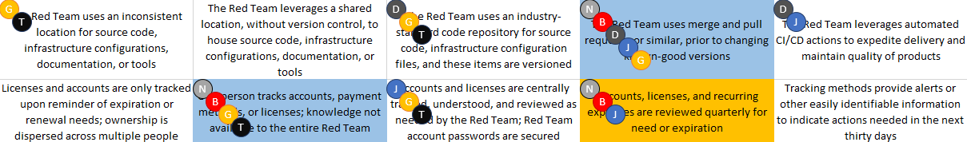
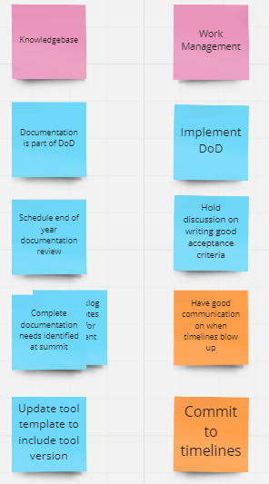
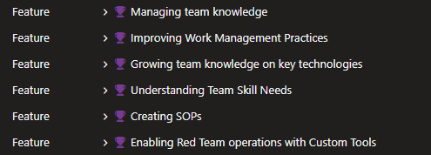
Current Level Scores
(required)
2023 Targets (majority)
2023 Stretch Targets (rare)
Independent Team Scoring
1
3
2
3
3
1
2
4
3
3
4
3
5
4
3
2
2
3
2
2
3
5
3
4
3
5
5
1
4
3
4
1
3
4
1
3
Delta Analysis and Friendly Arguing
Build a Backlog
Notes:
G

Slide 20
Summary and Thanks
20
Notes:
B

Slide 21
Summary
New Resource
A new, community-owned Capability Maturity Model to plan for, and report on, Red Team maturity in a business-standard format
Where To Find It
The CMM can be found online at:
https://redteammaturity.com
How You Can Pitch In
We welcome contributions. Please view our GitHub page for guidance on submitting additions or modifications as well as to submit a change.
https://github.com/BCHarrell/redteamcmm
(also linked from the primary website)
21
Notes:
B
https://github.com/BCHarrell/redteamcmm
https://redteammaturity.com

Slide 22
New Contributors
We want to thank the following individuals for their contributions to this project and its predecessor
Johann Rehberger
Andy Grant
Matthew Bjornstad
Red Team Director, Electronic Arts
Head of Offensive Security, Zoom
Principal Security Engineer, Red Team, Charter Communications
Original CMM Contributors
Jordan Potti
Noah Potti
Trevin Edgeworth
Red Team Lead, Norton Life Lock
Senior Red Team Operator, Bishop Fox
Red Team Practice Director, Bishop Fox
22
Notes:
B

Slide 23
Questions?
Notes:
B / G

